Slide 1

Open science: making data and code open, accessible, and reproducible.
```{r, presentation info, echo = T}
author = "Ryan Eckert"
date = as.Date("04/10/2020", "%m/%d/%y")
cat(paste(author, date, sep = "/n"))
```
Ryan Eckert
2020-04-10

Slide 2
Goals.
We want:
to work on our code in a way that is version controlled and easily communicable
an effective way to share data and code
make our code easily reproducible
to archive our data and code so that it is always accessible and citable

Slide 3


Goals.
This allows transparency in our research and is helpful to others who are developing skillsets
We can accomplish all these goals effectively using free platforms: Rmarkdown, GitHub, and Zenodo

Slide 4
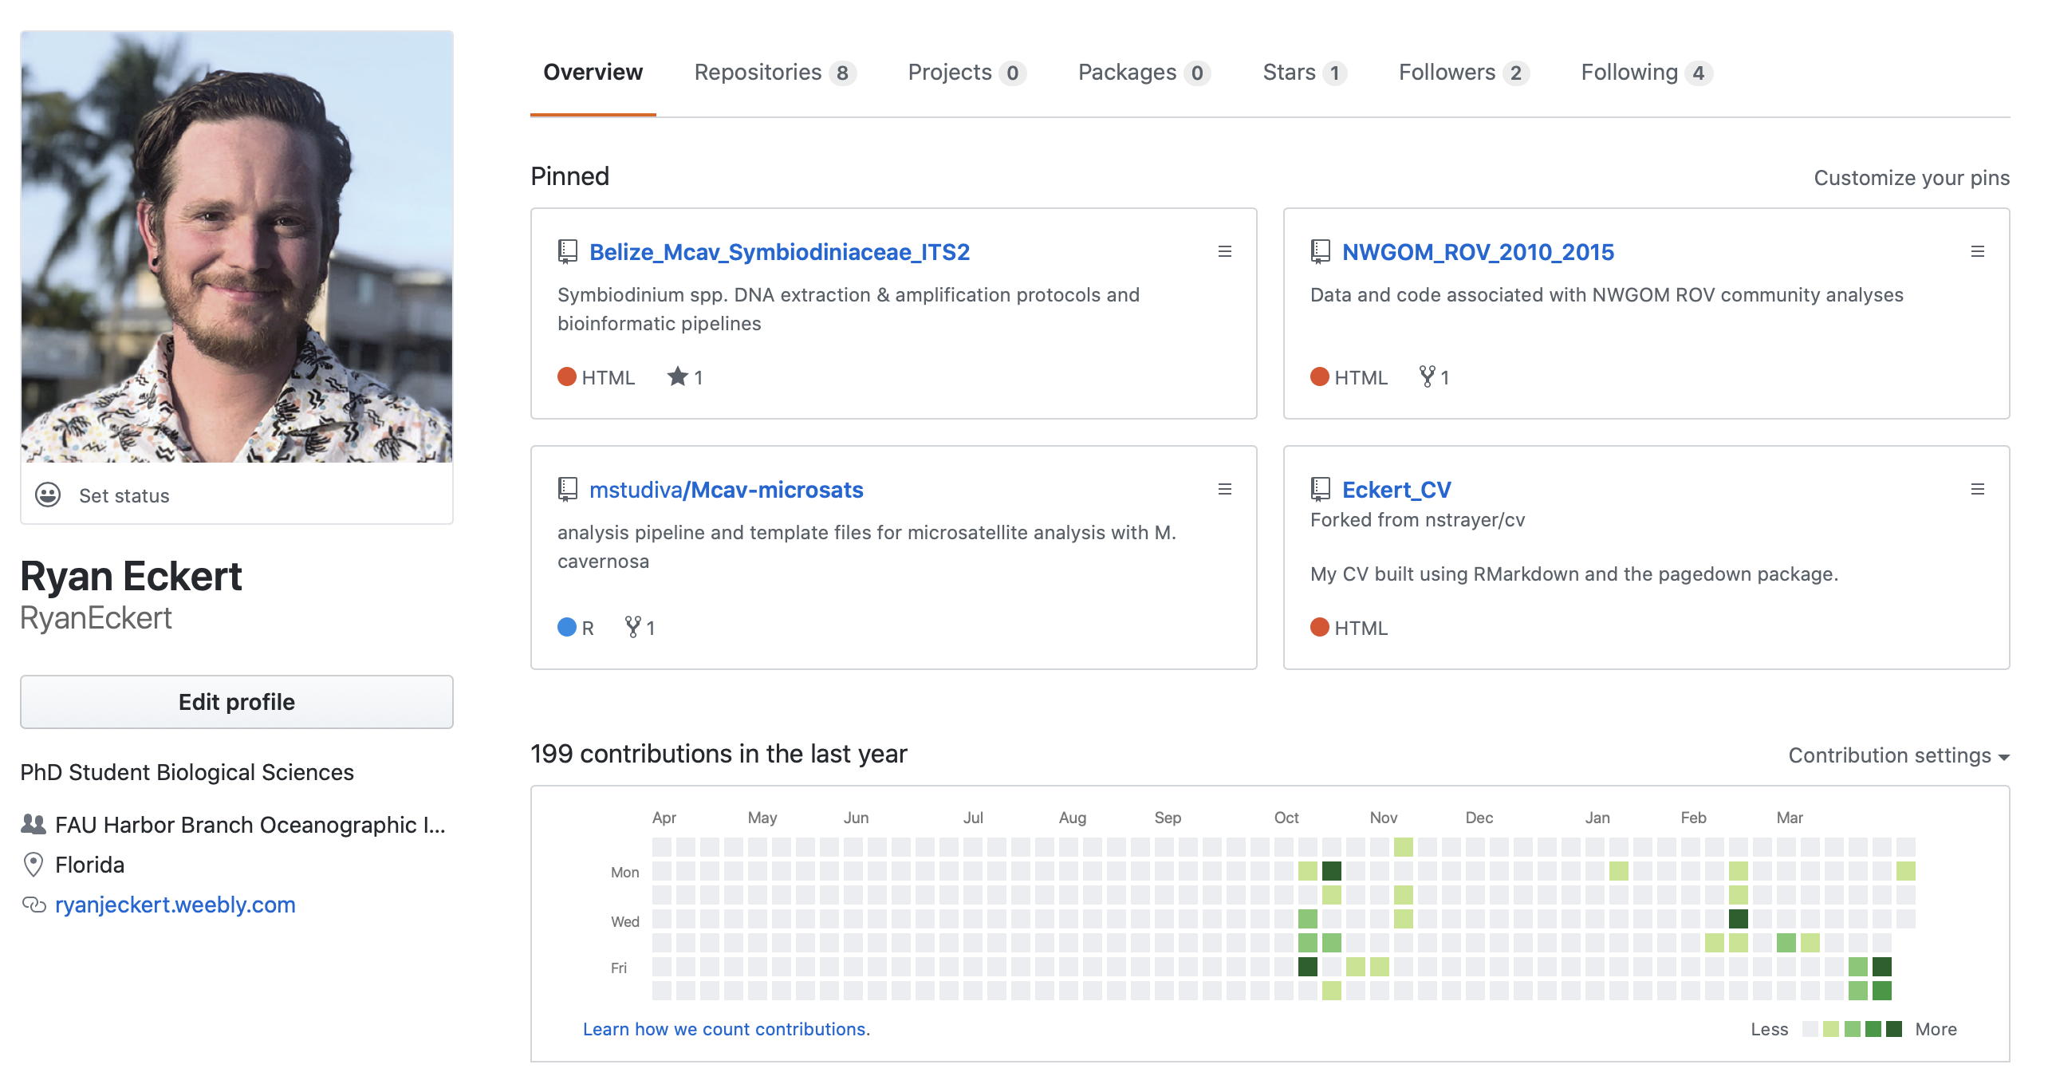
GitHub.
Development platform
Site to host and review code
A way to collaborate on programs/projects
Fork repositories of interest
Clone repositories from others
Version control system (VCS)

Slide 5
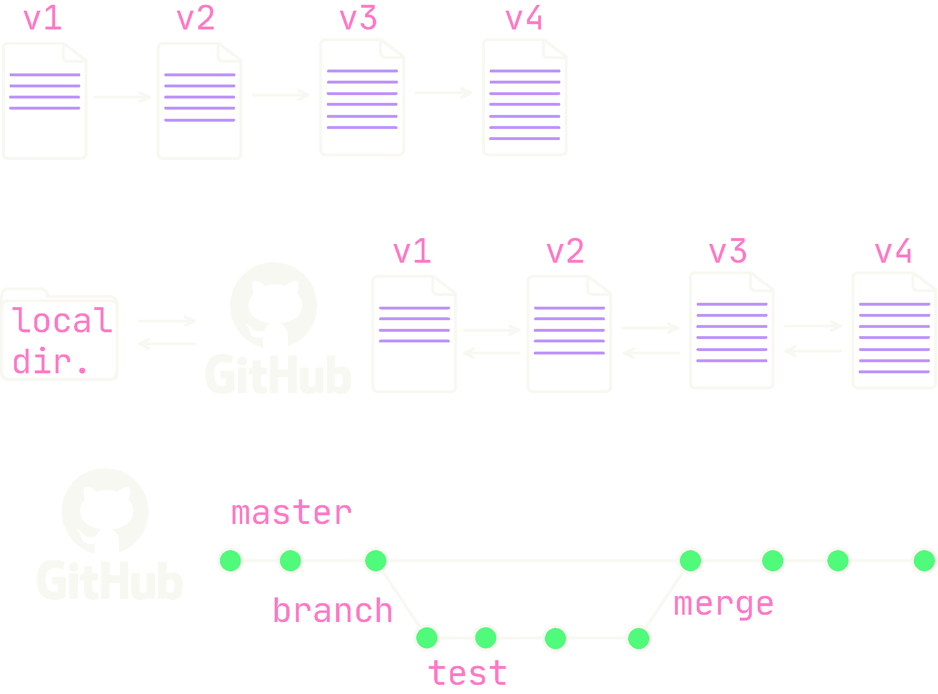
GitHub.
Working locally on code is often destructive—versions replace one another
Using GitHub allows us to easily implement version control—changes are documented between versions *This depends on how often you commit to GitHub*
Additionally, we can branch to work on issues away from the master experimentally. If we are happy with changes we can merge this branch back to the master

Slide 6
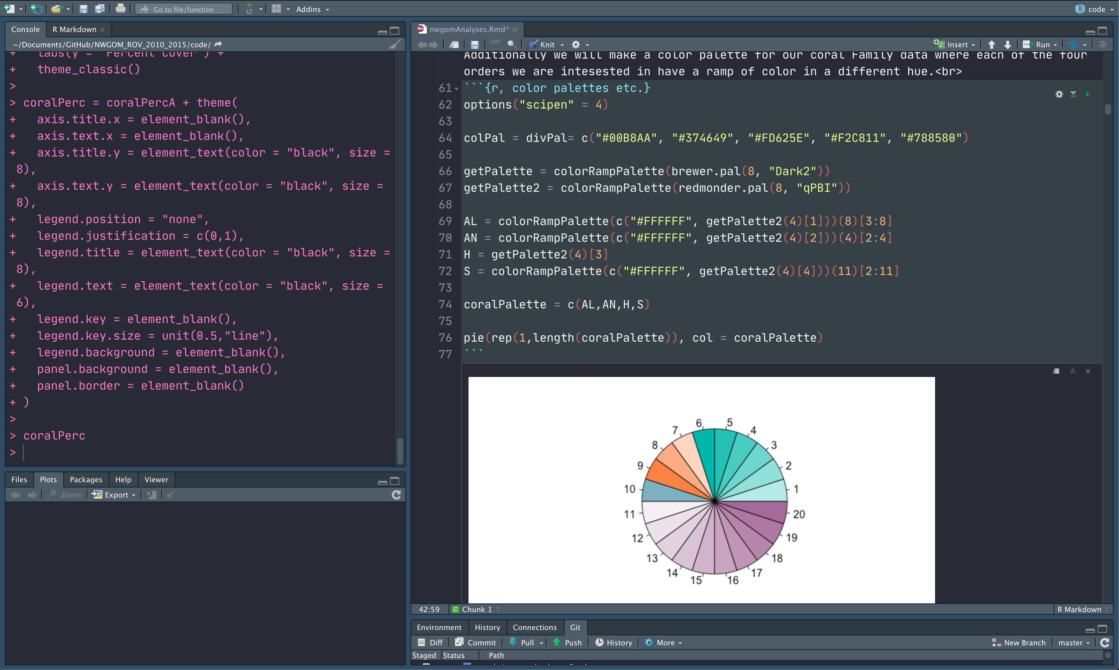
Rmarkdown.
Notebook interface
Create dynamic documents
Create websites, CVs, books, articles, presentations, etc.

Slide 7
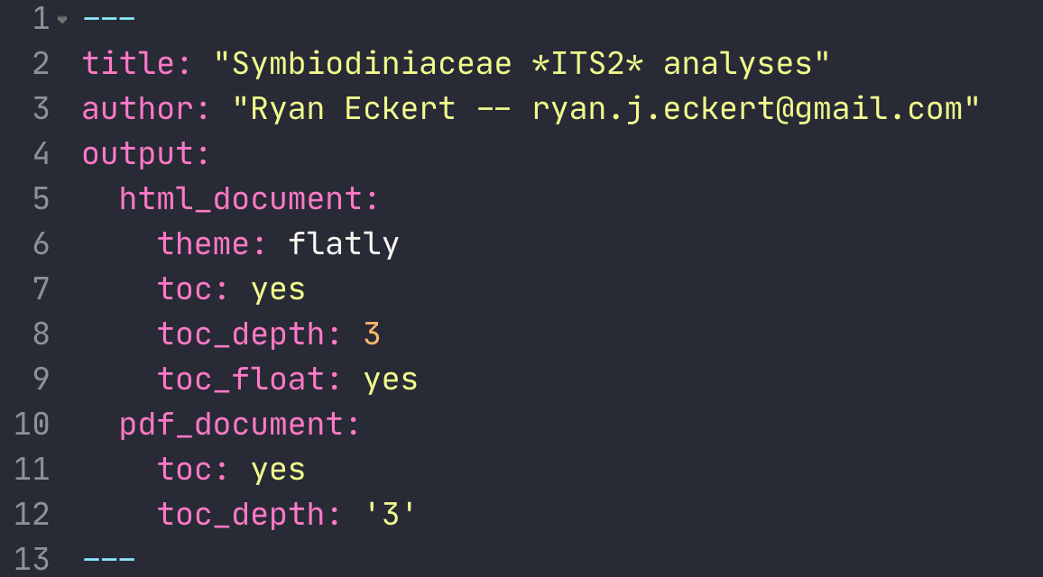
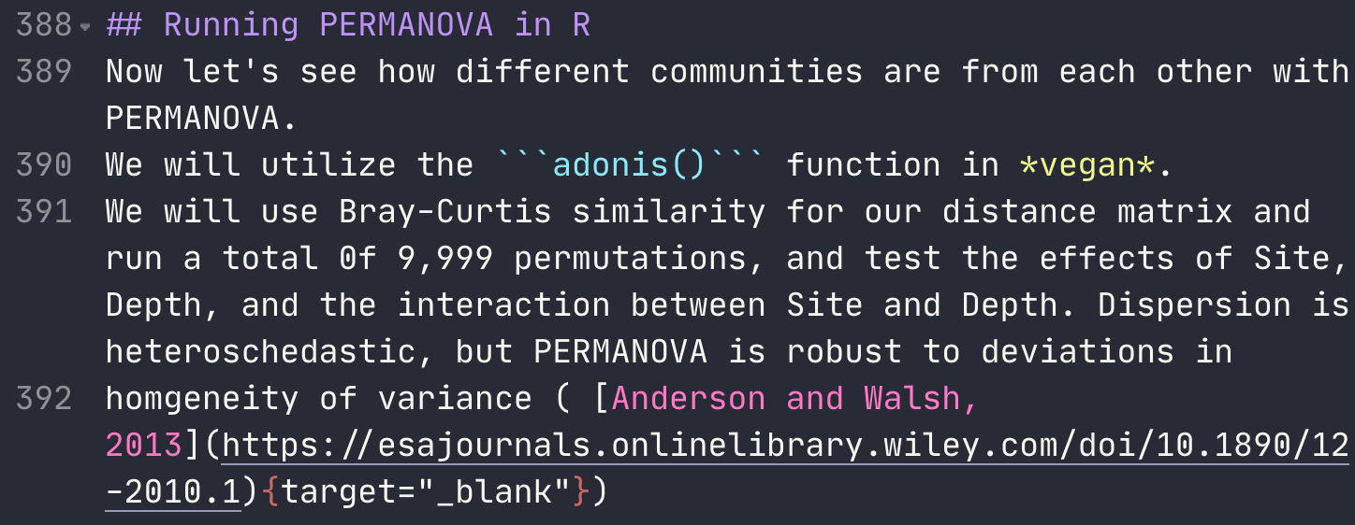
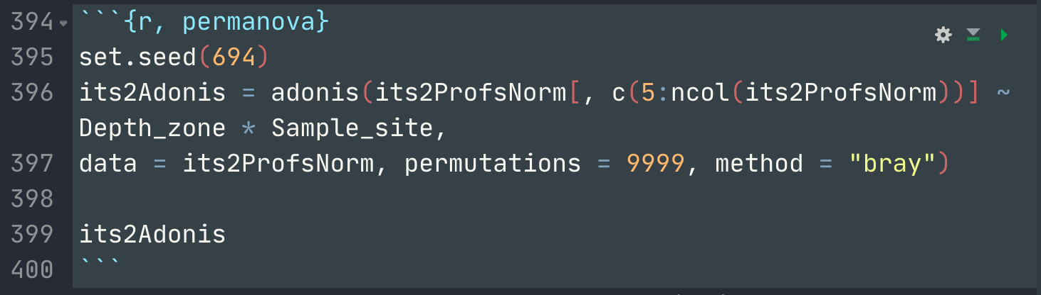
Rmarkdown.
Three main components:
YAML header
Set options
Body text
Html, markdown, plain text
Code Chunks
Specify language and options for knitting

Slide 8
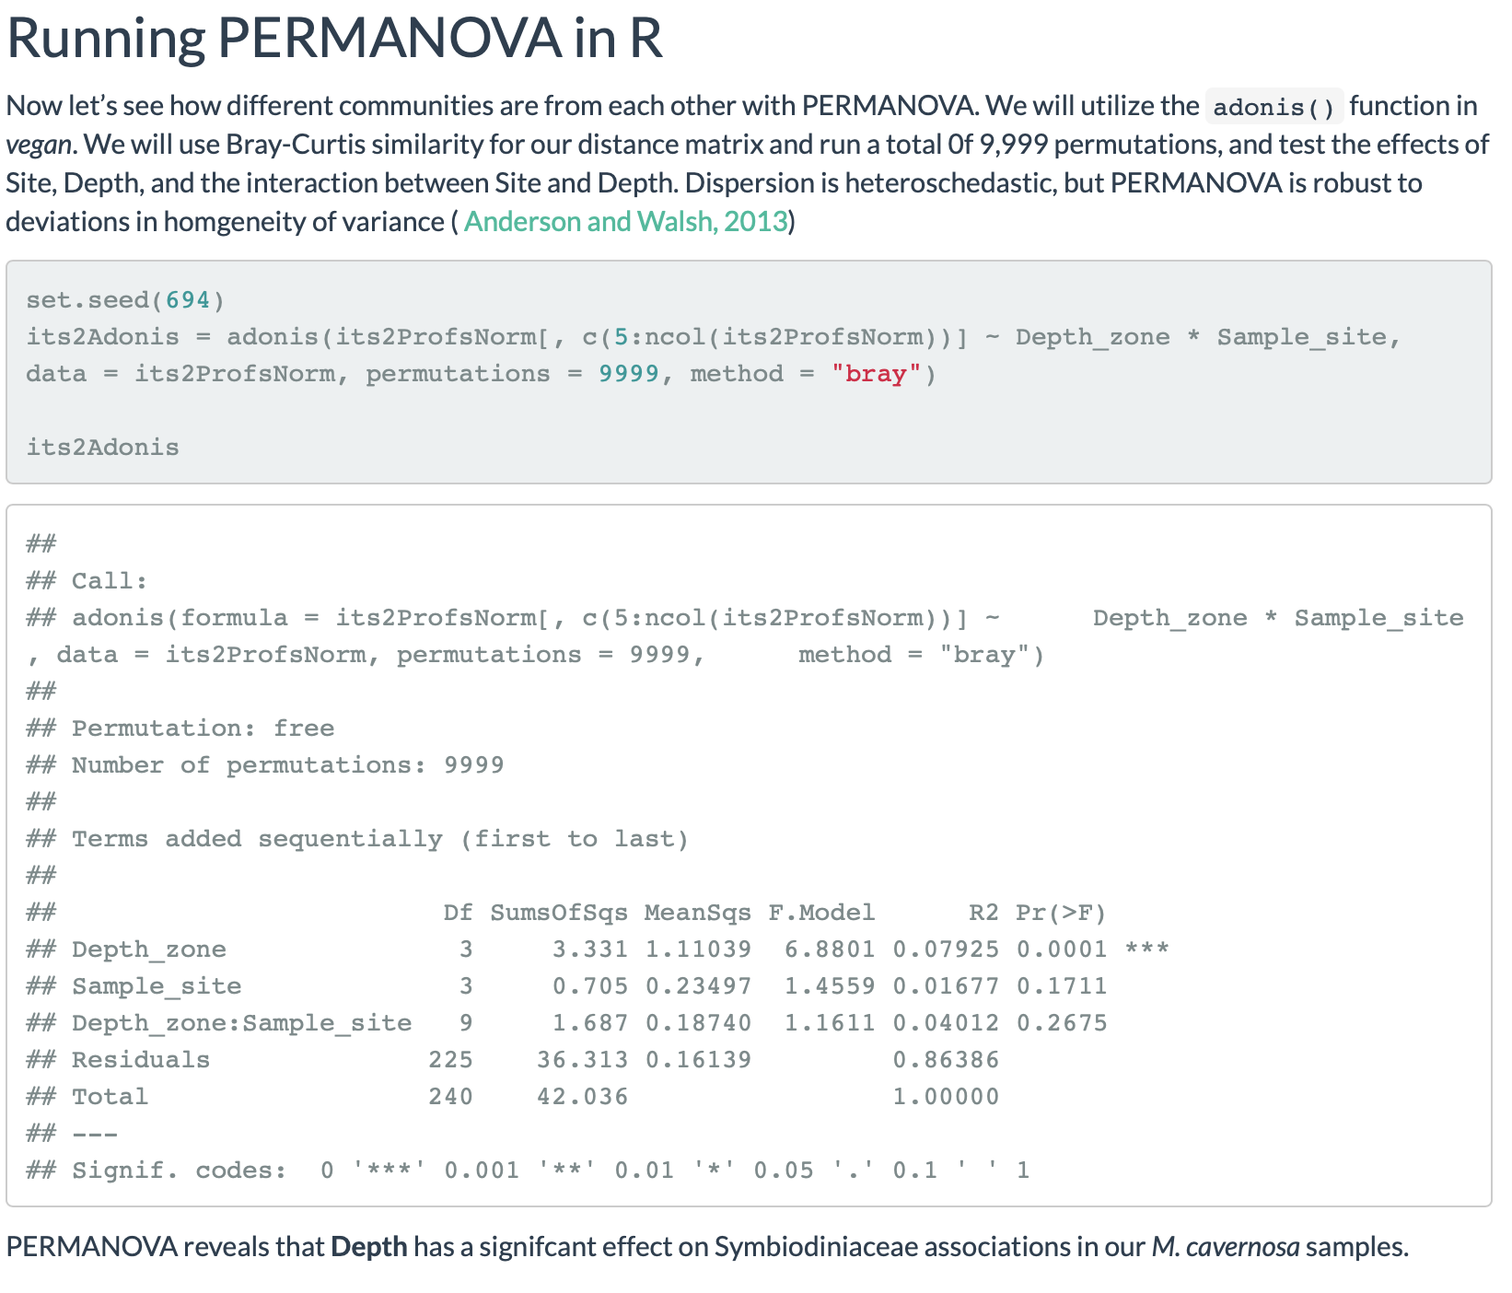
Rmarkdown.
Knit to a document
.html; .pdf; .docx & more

Slide 9
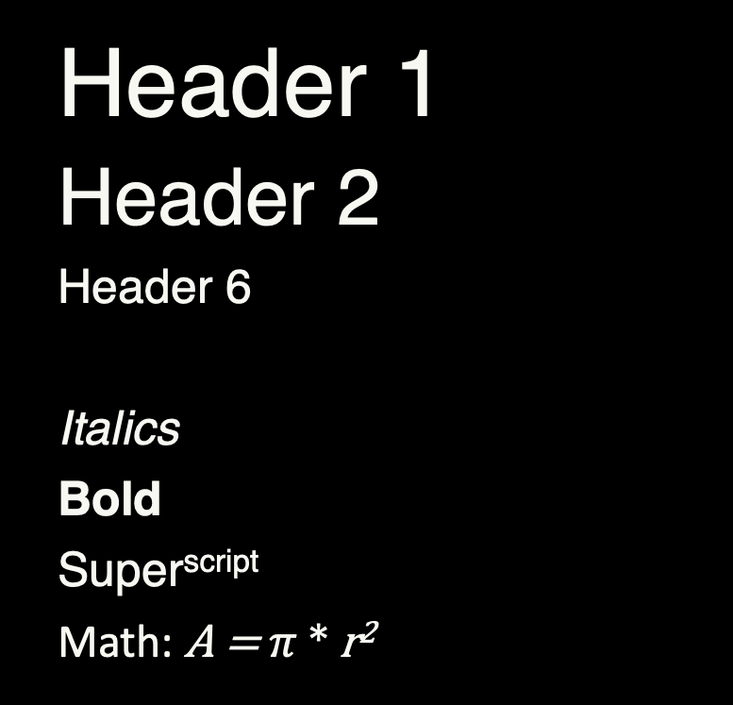
Rmarkdown quick cheat sheet.
Header 1
Header 2
Header 6
Italics
Bold
Super^{script}
Math: A = $π$ * r²
# Header 1
## Header 2
###### Header 6
***
*Italics*
**Bold**
Super^script^
Math: $A = \pi*r^{2}$

Slide 10
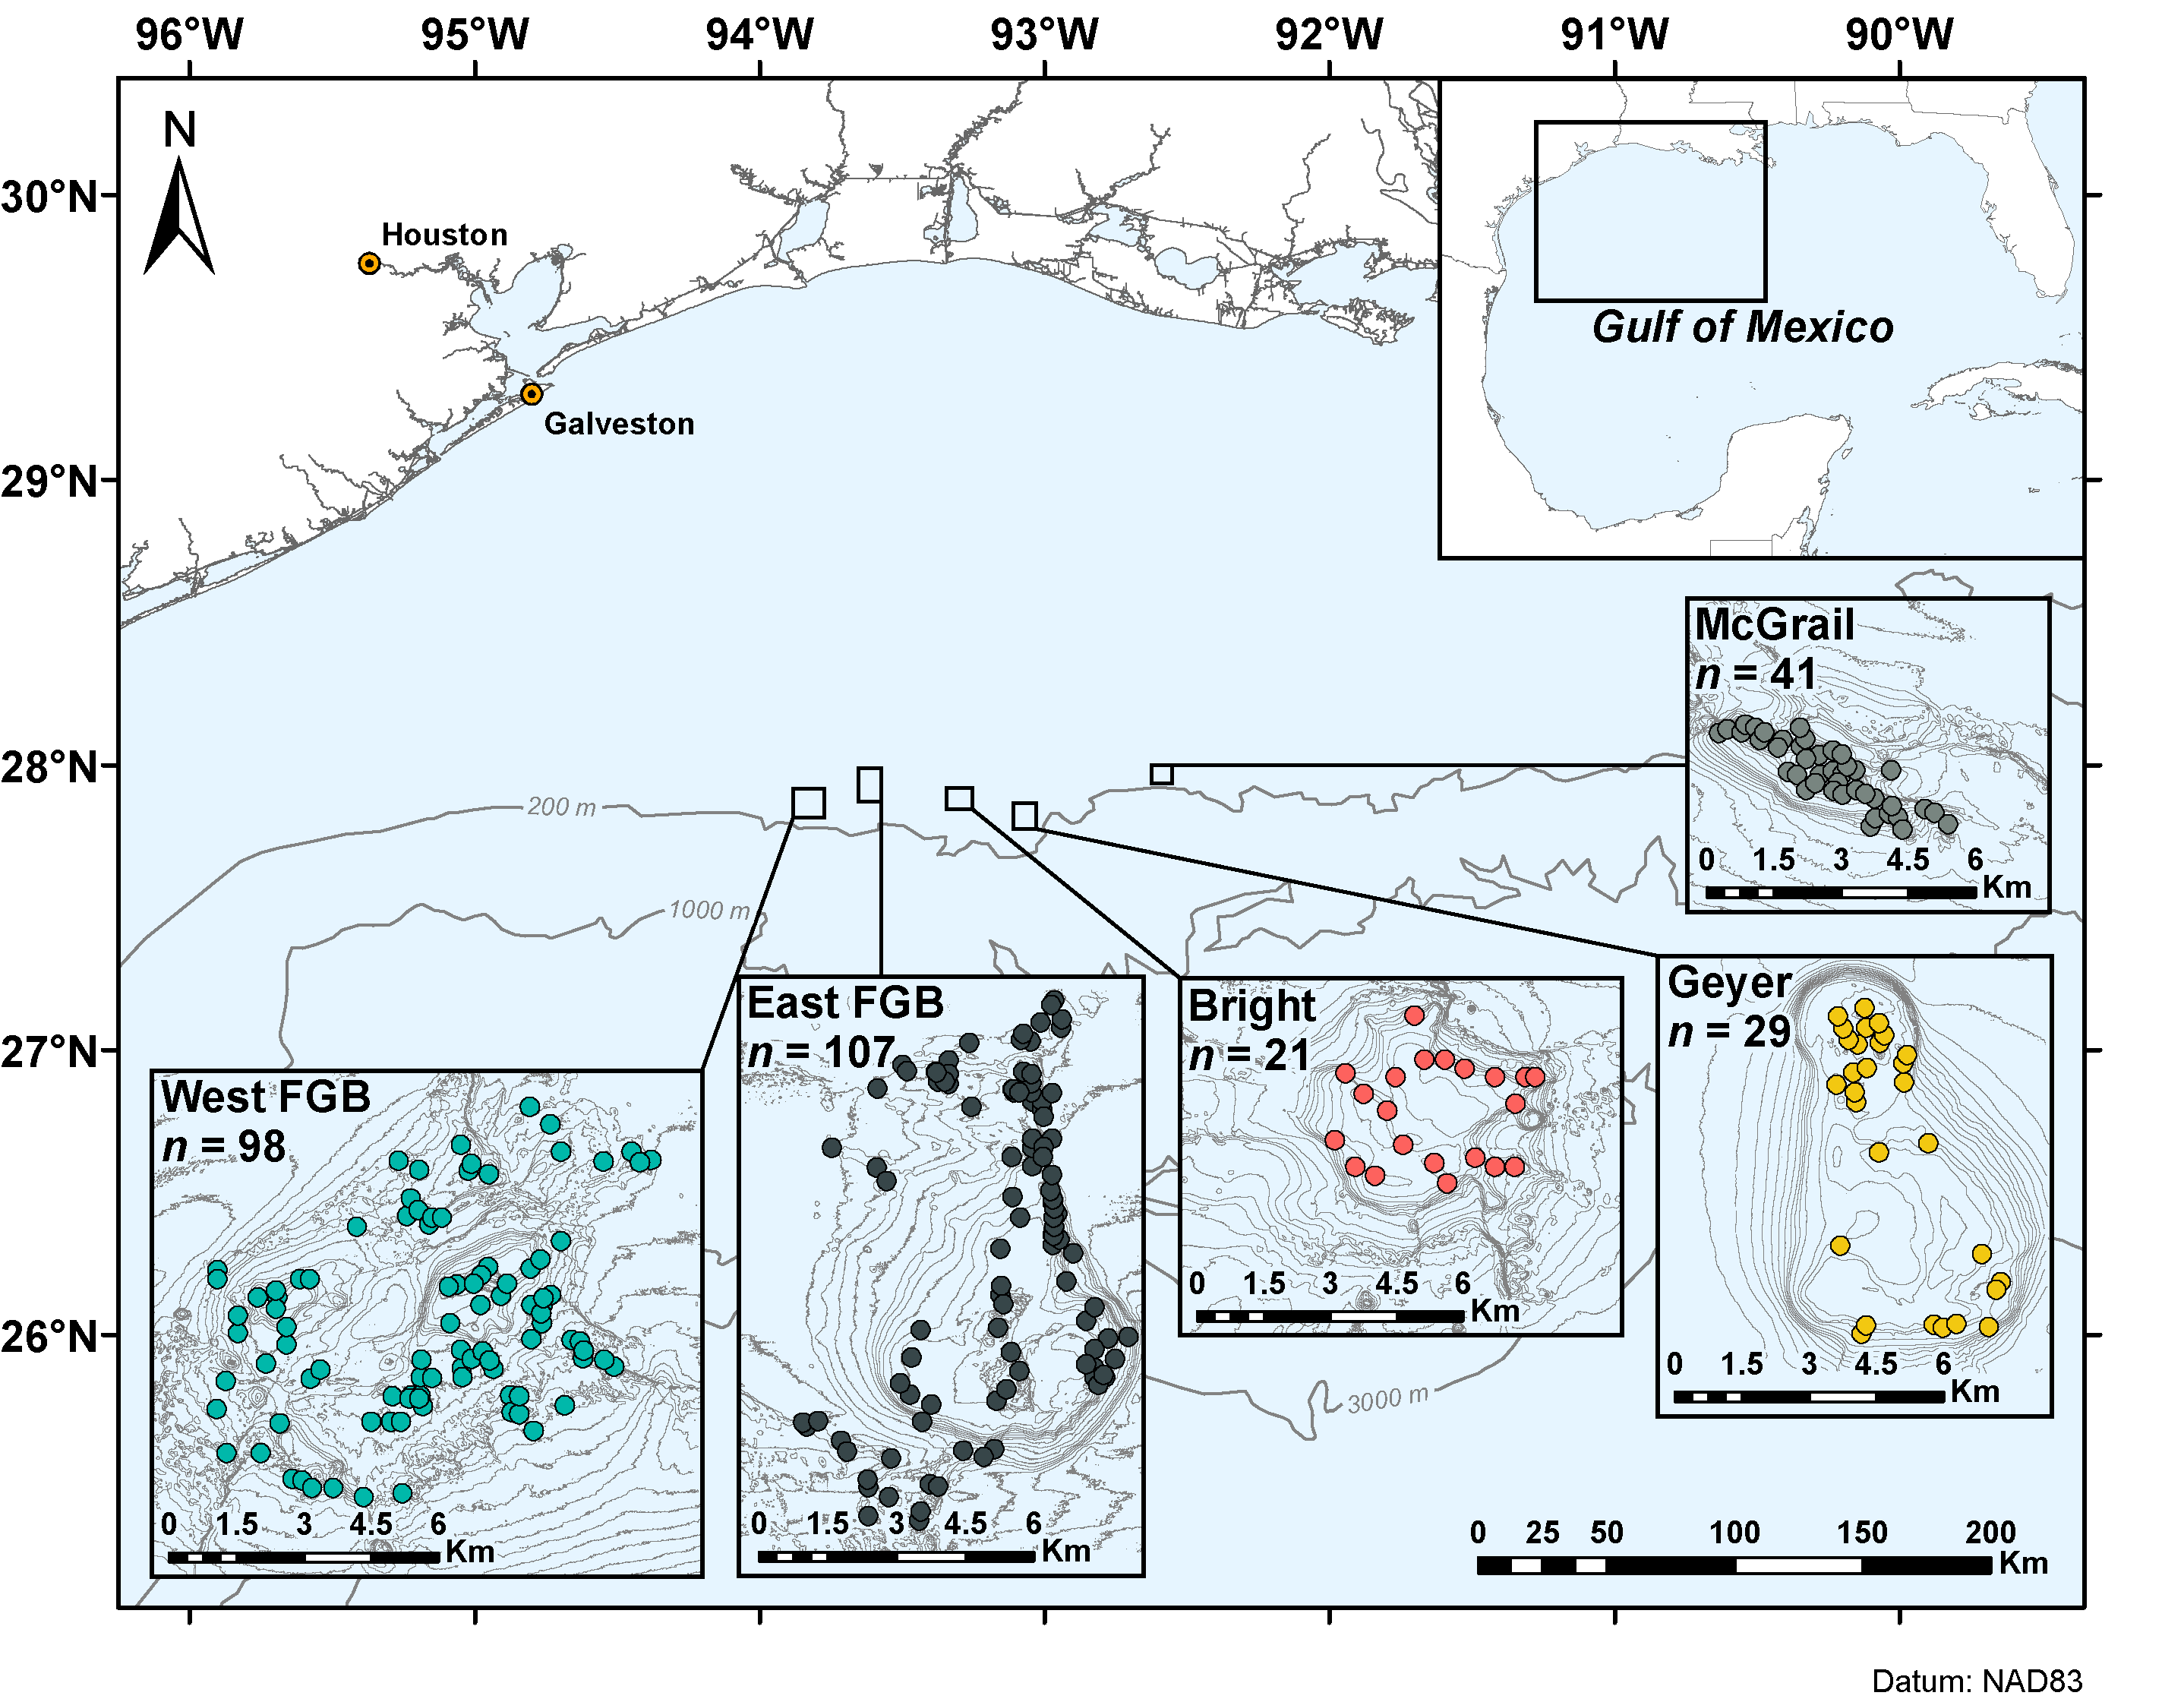
Rmarkdown quick cheat sheet.
* Unordered
* list
+ with bullets
1. Ordered
2. list
+ with numbers
![Figure 1](path/to/image.png)
Unordered
list
with bullets
Ordered
list
with numbers

Slide 11
Rmarkdown quick cheat sheet.
```{language, name, parameters}
Code chunk
```
print code `inline`
`r paste(“run code inline”)`
[Hyperlink](https://ryanjeckert.weebly.com){target=“_blank”}
```{language, name, parameters}
Code chunk
```
Print code inline
run code inline
Hyperlink

Slide 12
Zenodo.
Open-access repository
Can permanently archive data, metadata, and code
Link to GitHub repo and create a DOI

Slide 13
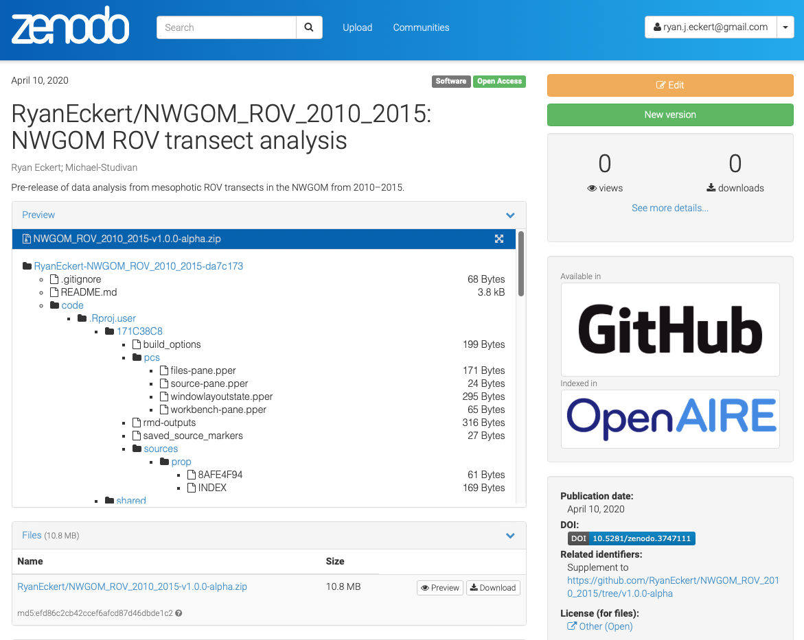
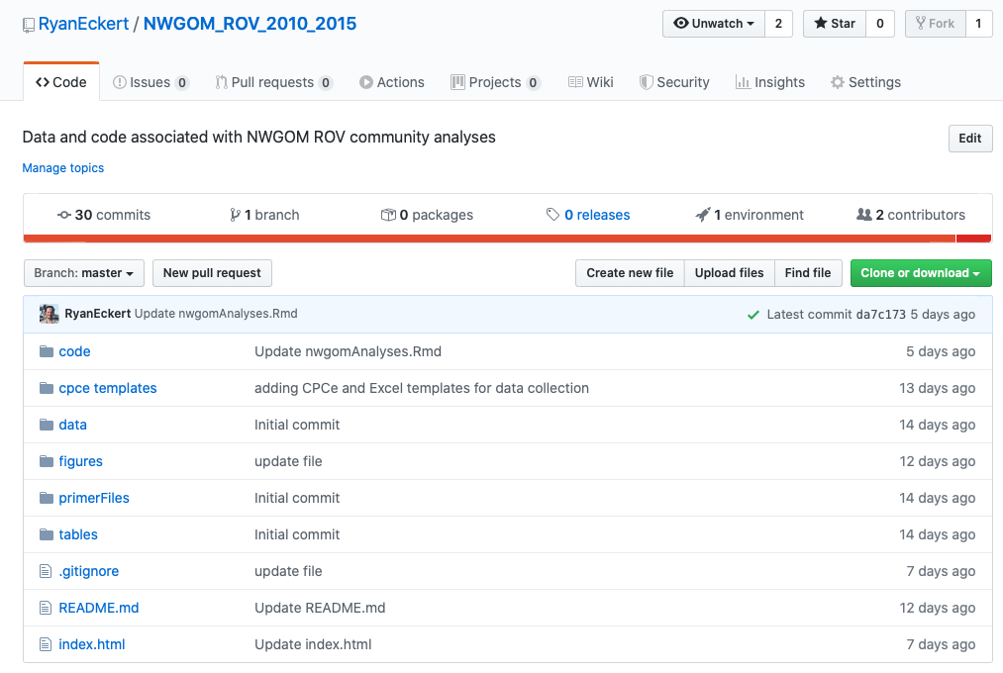
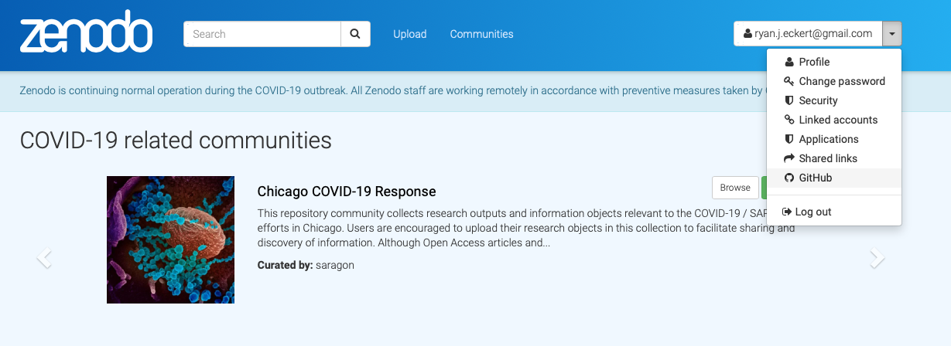
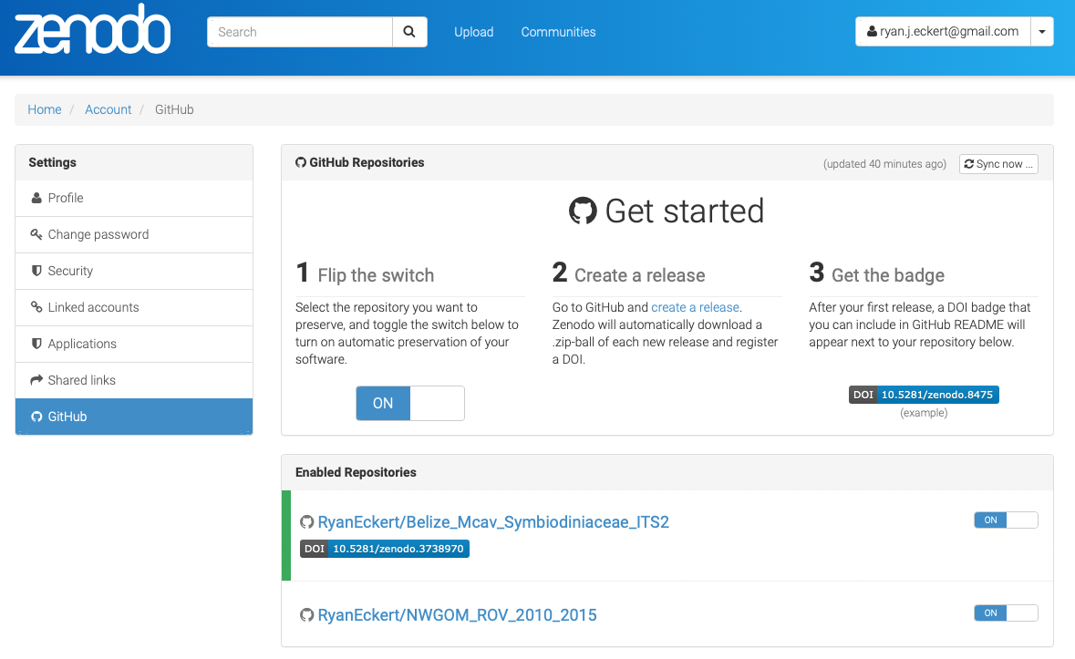
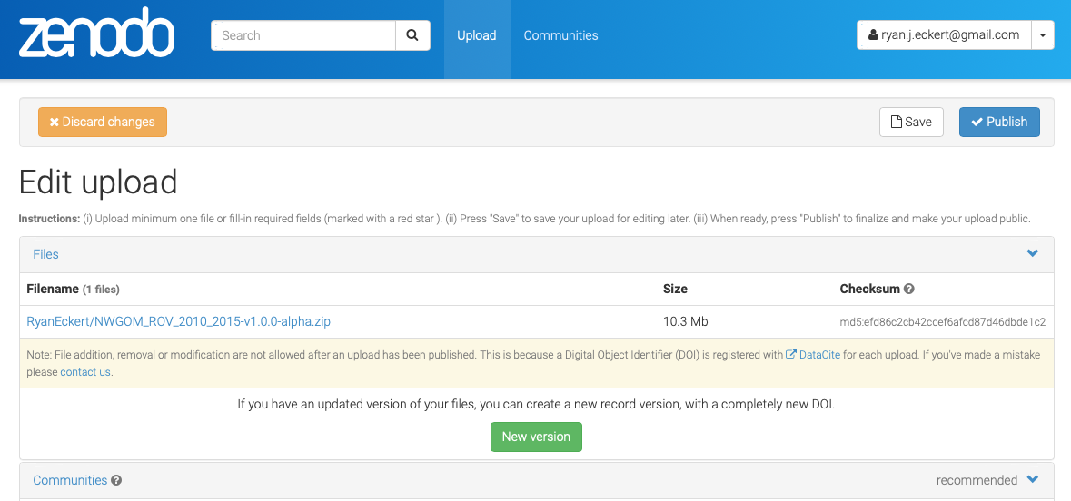
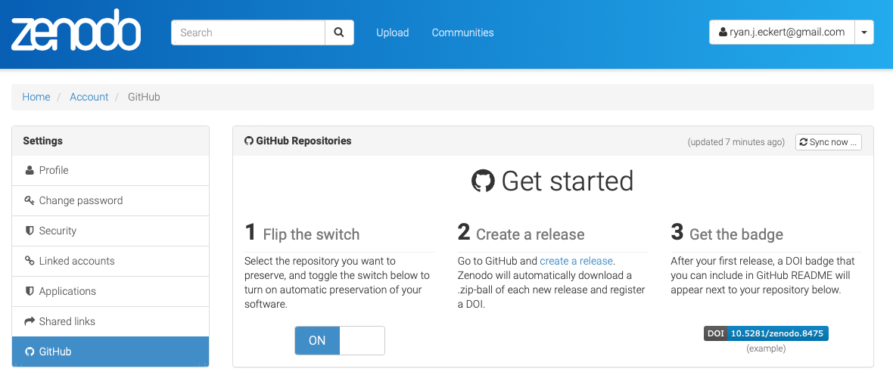
Zenodo.
Log in to Zenodo (zenodo.org) with GitHub account
Authorize application: Zenodo
Go to GitHub tab in Zenodo
Toggle switch to “ON” for selected repo
Create a release on GitHub
Complete info for release on Zenodo under upload
Save edits and publish

Slide 14
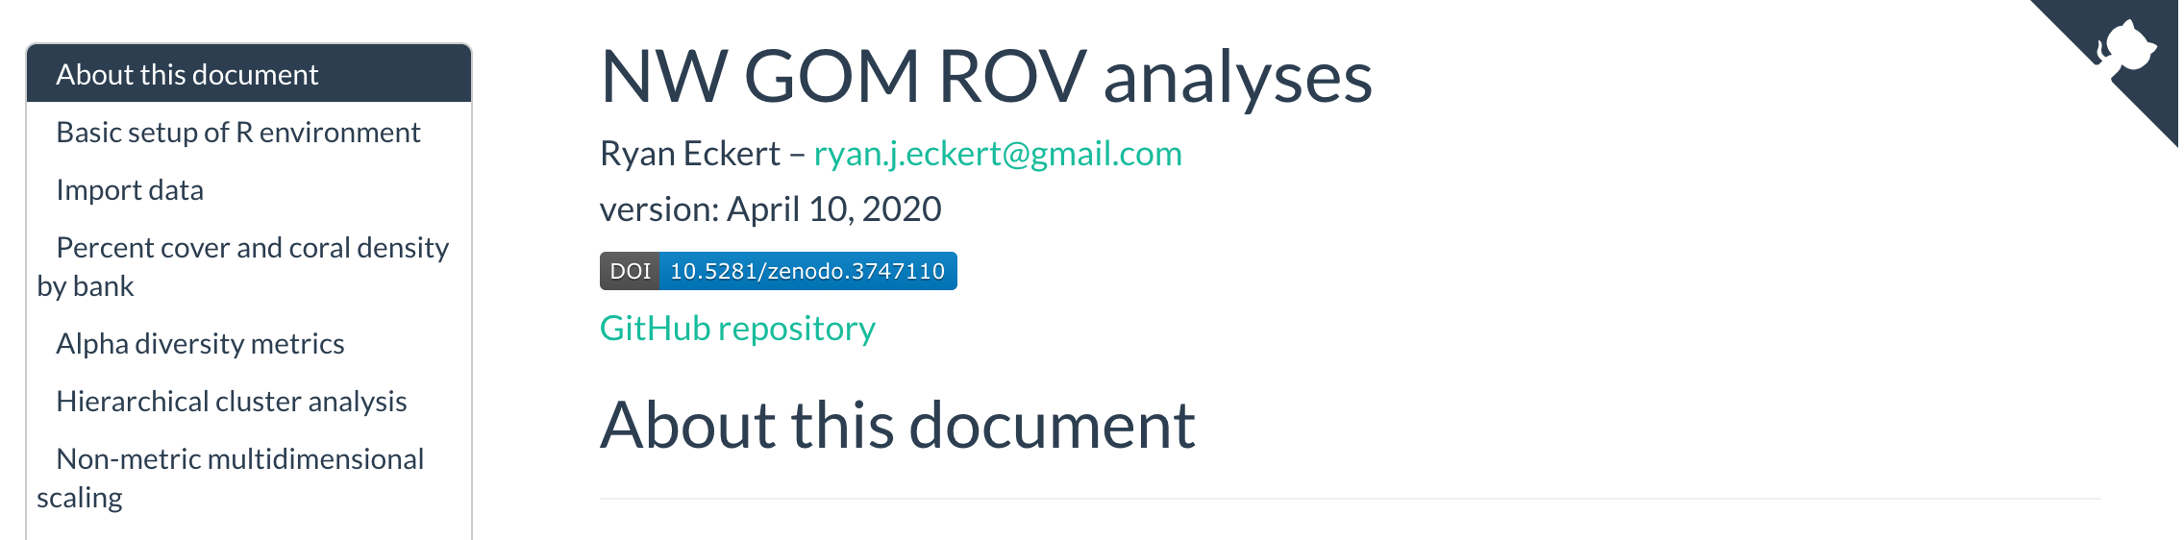
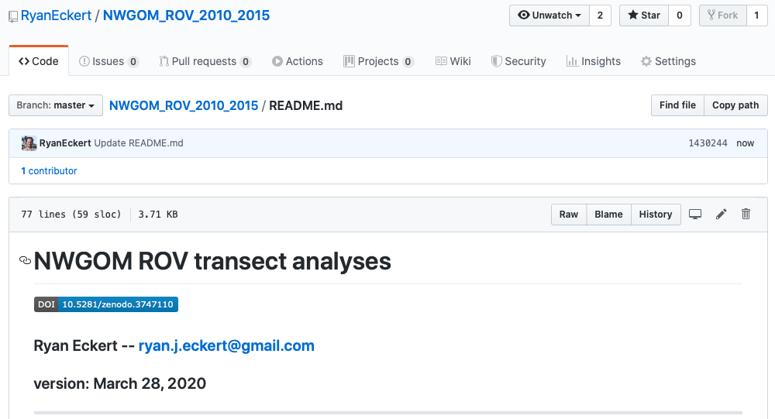

Zenodo.
Now you should see a DOI badge on Zenodo
Since we know how to write markdown we can include the DOI badge on our GitHub and in our Rmarkdown documents.

Slide 15

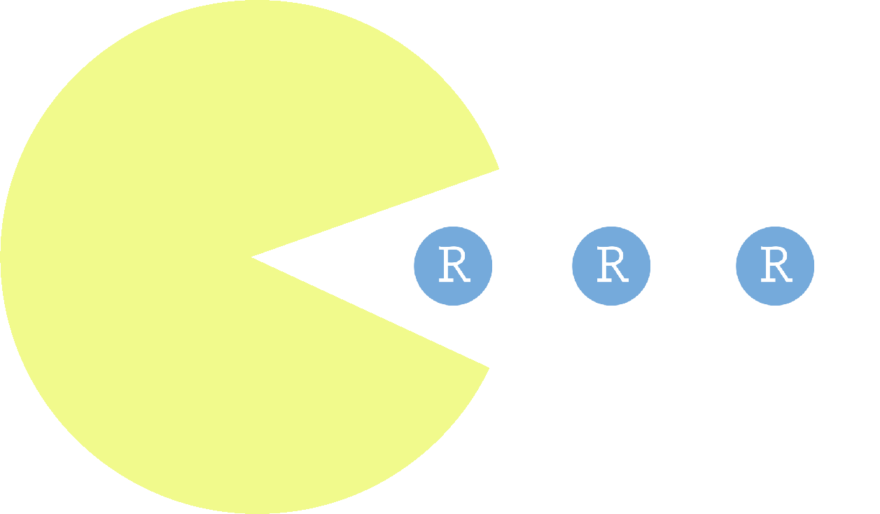

Programs & packages.
Rstudio (https://rstudio.com/products/rstudio/download/)
rmarkdown ( install.packages(“rmarkdown”) )
pacman ( install.packages(“pacman”) )
tidyverse ( install.packages(“tidyverse”) )

Slide 16


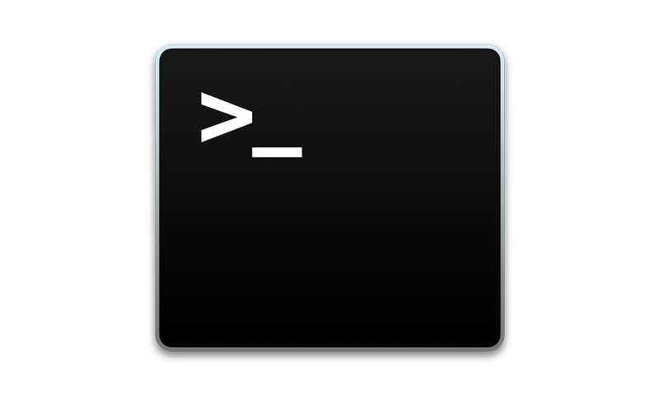
Programs & packages.
GitHub Desktop (https://desktop.github.com)
Atom (https://atom.io/download/)
Terminal (Mac)

Slide 17
Best practices/recommendations.
Initialize a GitHub repo for data analysis
Create an R project file for new repo (.Rproj)
START writing code in Rmarkdown
Spend time upfront creating publishable figures

Slide 18
Best practices/recommendations.
Commit to GitHub often while working to maintain good VC
Submit raw sequences to NCBI SRA (or equivalent)
When publishing, create a Zenodo archive for GitHub repo and create DOI

Slide 19
Tips & tricks.
Look at GitHub repos/code from papers with analyses/plots you want to use
Stackoverflow.com
Use tidyverse for data manipulation/plotting
Color palettes: paleteer ( install.packages(“paletteer“) ); create your own with: colorRampPalette()

Slide 20

Tips & tricks.
Use dark themes in Terminal, Atom, Rstudio, etc. to reduce eye strain/fatigue (I like Dracula or SMYCK)
Change font to help with readability
(I prefer JetBrains Mono)
Keep everything CONSISTENT and UNIQUE
No variables with the same name over and over (i.e. df, plot)

Slide 21
Tips & tricks.
I use caterpillarCase for variables and objects
thisMakesItEasierToRead (for me)
I_prefer_it_over_all_these_god_damn_underscores-or-fucking-hyphens
Keep variables and objects short when possible
northwestGulfOfMexicoRovOnlyCoralSpecies = read.csv(nwgomCoral.csv)
nwgomCoral = read.csv(nwgomCoral.csv)
I keep spaces in my code when allowed/optional (e.g. R)
This = much(easier = “on the eyes”, in my opinion)
This=becomes(very=“tedious”,to,read,over=time)

Slide 22


There is not one right way.
This is typically how I do things.
I have found that this workflow works well for me.
Ultimately, these are guidelines to help introduce ways to work effectively and commit to open science.
Take these ideas and implement a system that works well for you.
Freak what you feel.

